Slide 1
SUSTAINABLE CITY
MINECRAFT
TEAM 4

Slide 2

Our city is made up of:

Slide 3
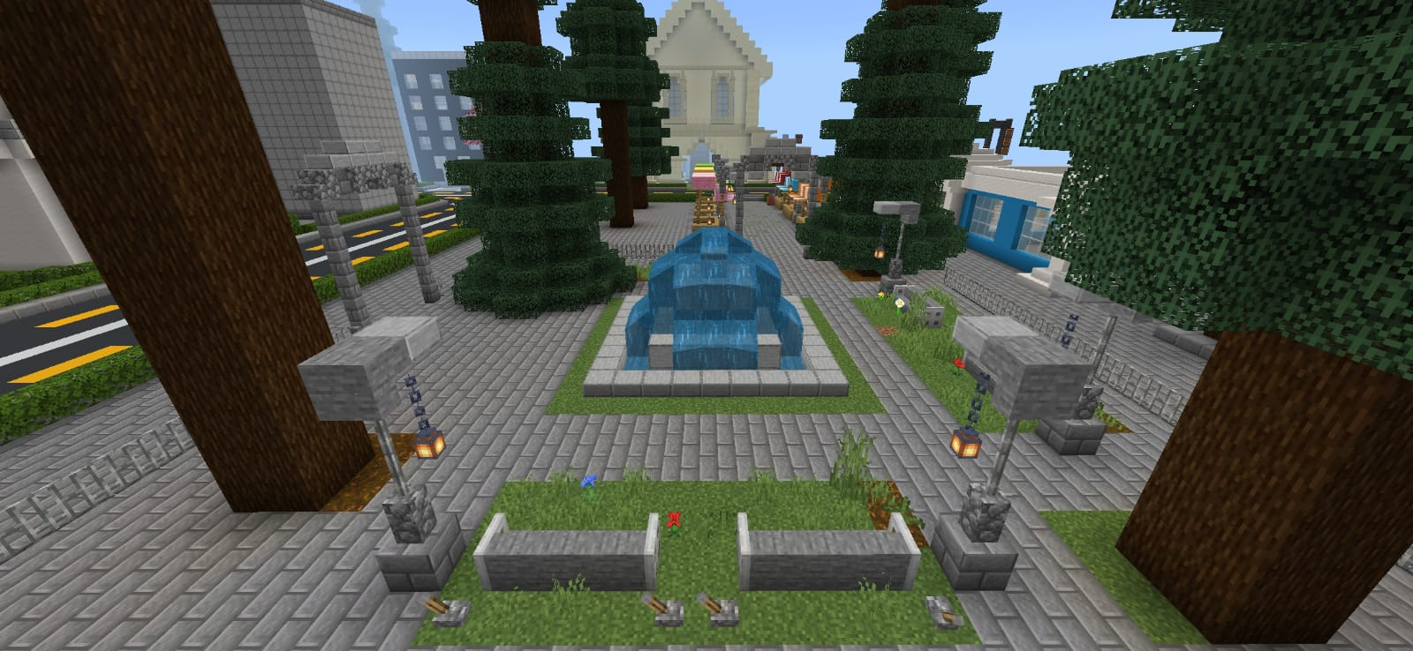
SQUARE
The square is an urban space free of buildings, which values ​​the natural environment, as well as having aesthetic and symbolic reference objects in the city's landscape. Its functions are to socialize, integrate and provide leisure for the local community and tourists.

Slide 4
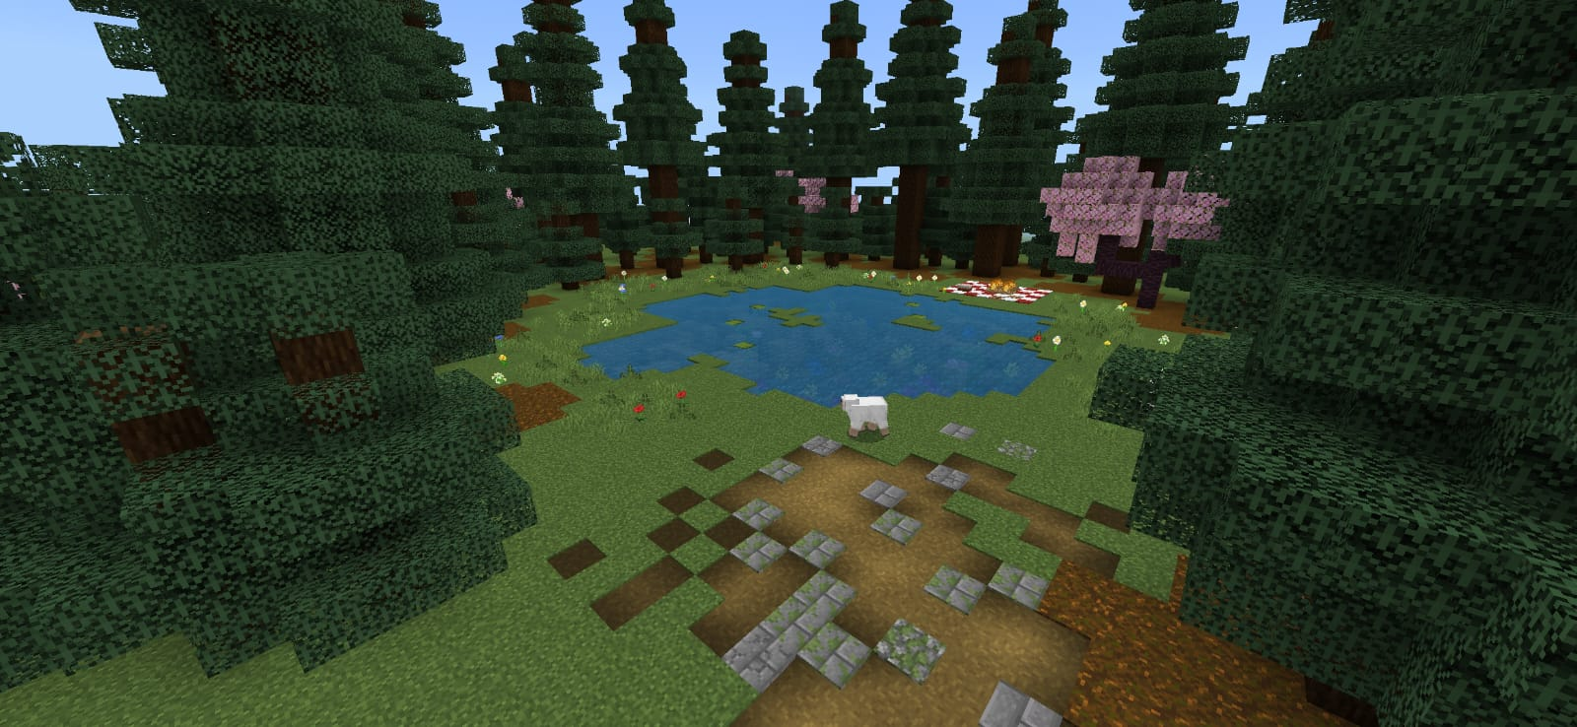
LAKE
Especially when close to cities and urbanized areas, lakes are very important for water supply, transport and the development of the local economy, serving leisure and tourism.

Slide 5
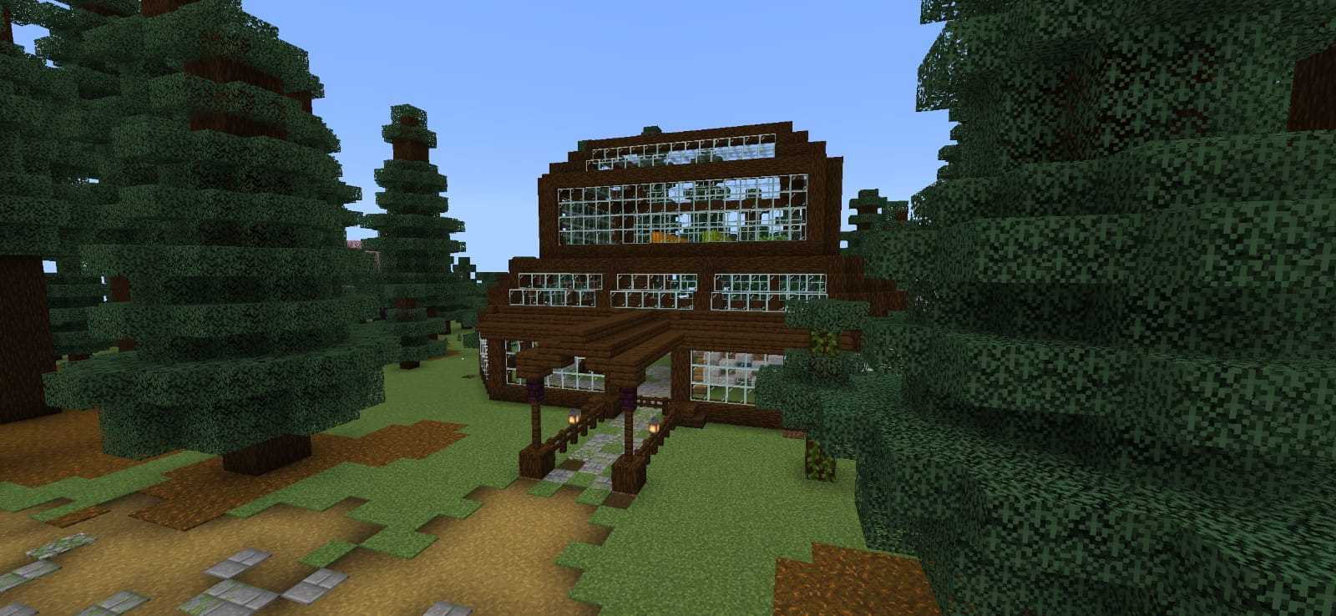
PLANTATION
Plantation generates oxygen, food, fiber, fuel and medicine that allow humans and other life forms to exist. They are also essential for controlling the Earth's temperature and the balance and dynamics of water on the planet.

Slide 6
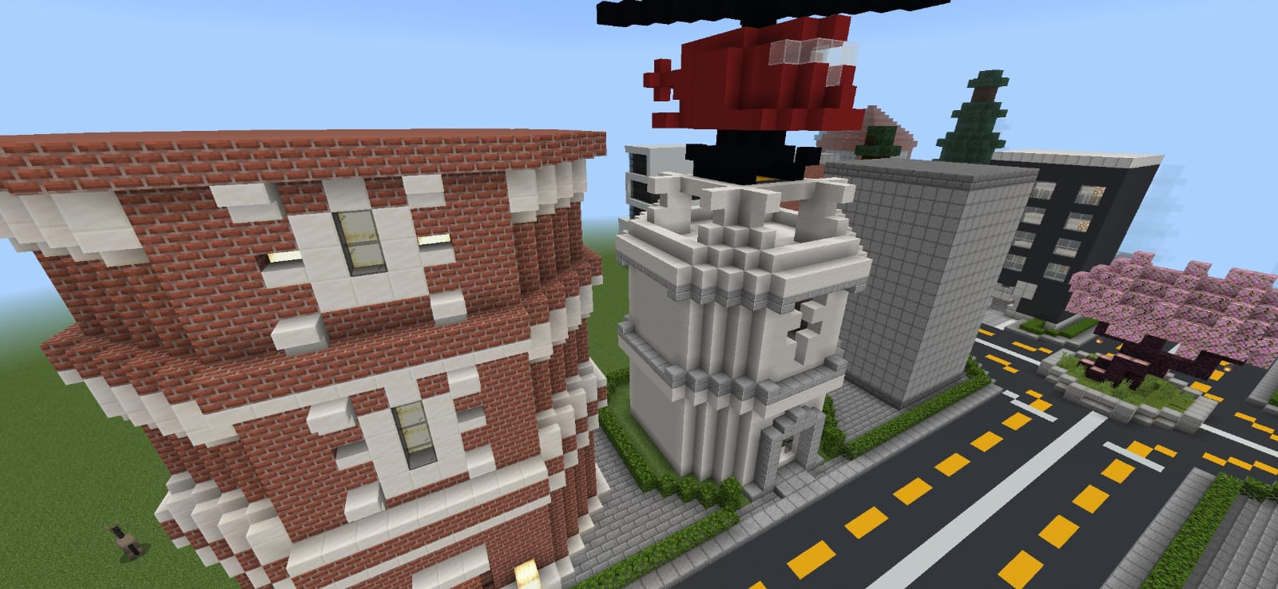
HOSPITAL
The hospital can be defined as an integral part of a medical and social organization, whose basic function is to provide the population with comprehensive, curative and preventive medical care, under any care regime, including home care.

Slide 7
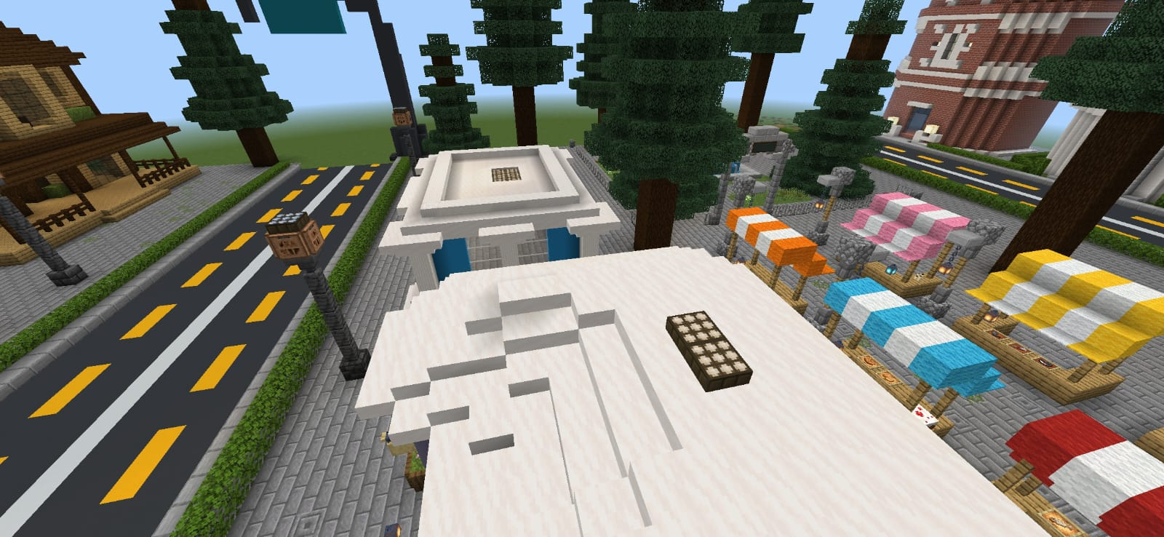
SOLAR PLATES
The solar panel is a robust piece of equipment whose function is to capture the sun's rays and transform them into electrical energy. This makes it possible to supply electricity to homes, commercial establishments and factory environments.

Slide 8
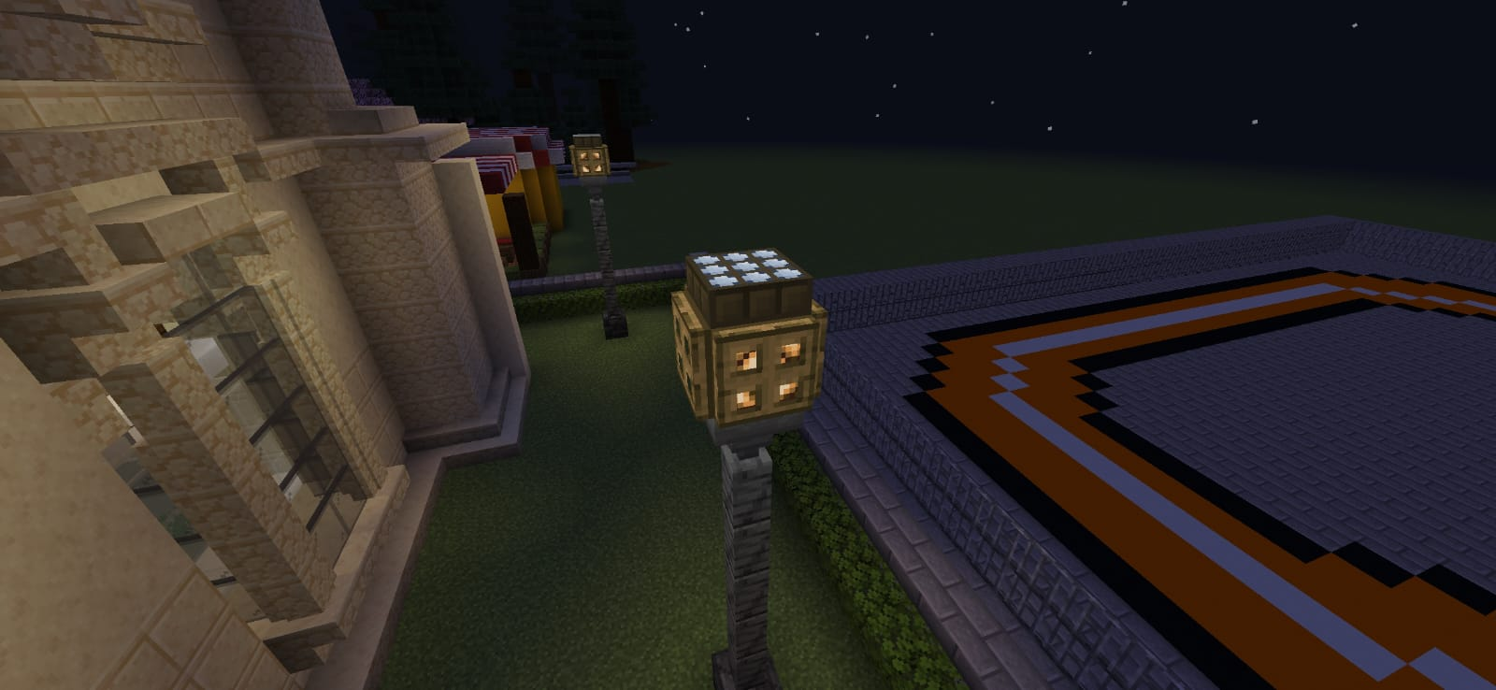
Posts that are solar panels.

Slide 9
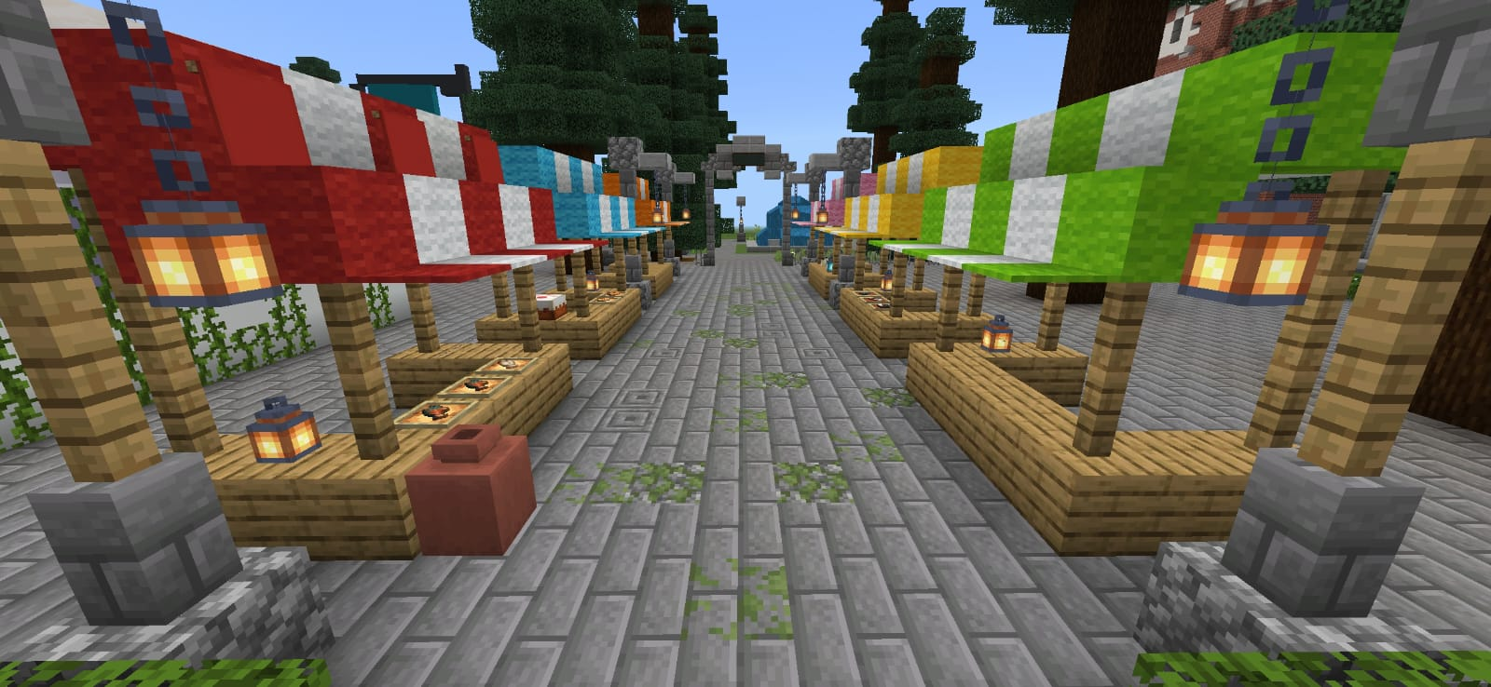
MARKET
In addition to being an important food supply channel, open-air markets represent a place where people interact with each other and give small local rural producers the opportunity to sell their products without intermediaries.

Slide 10
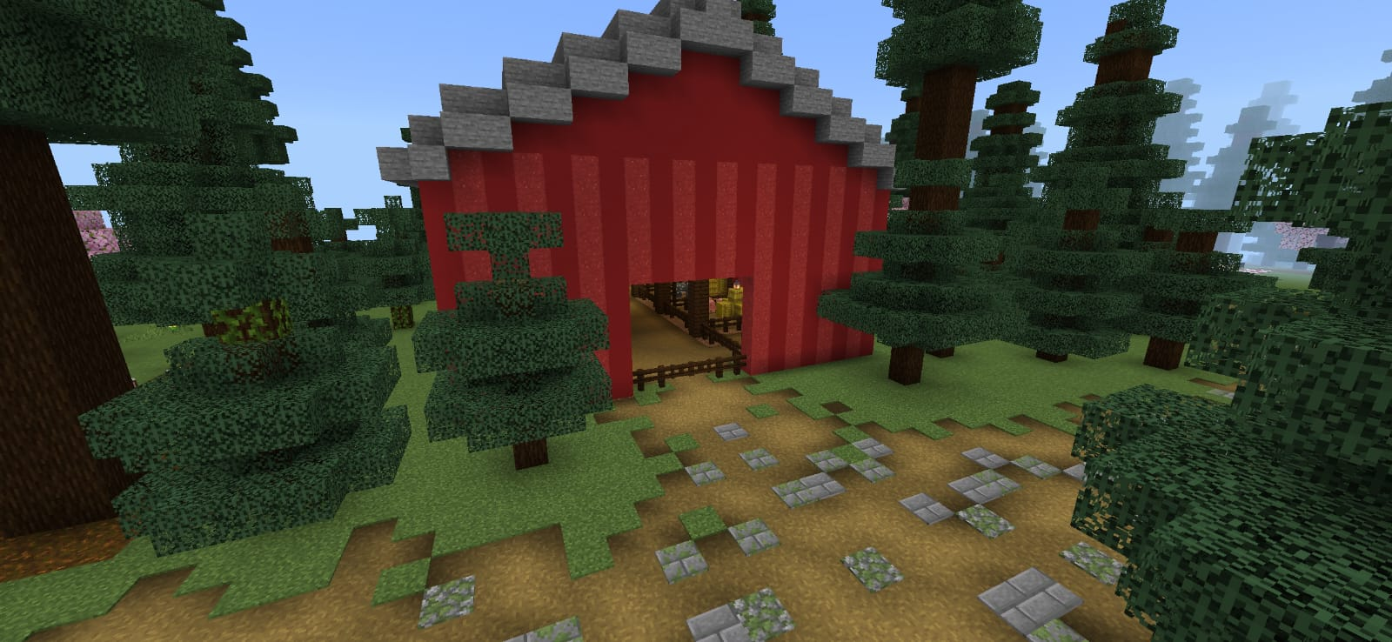
COUNTRY HOUSE
A country house is a small rural property on the outskirts of a city, intended for cultivation or leisure.

Slide 11
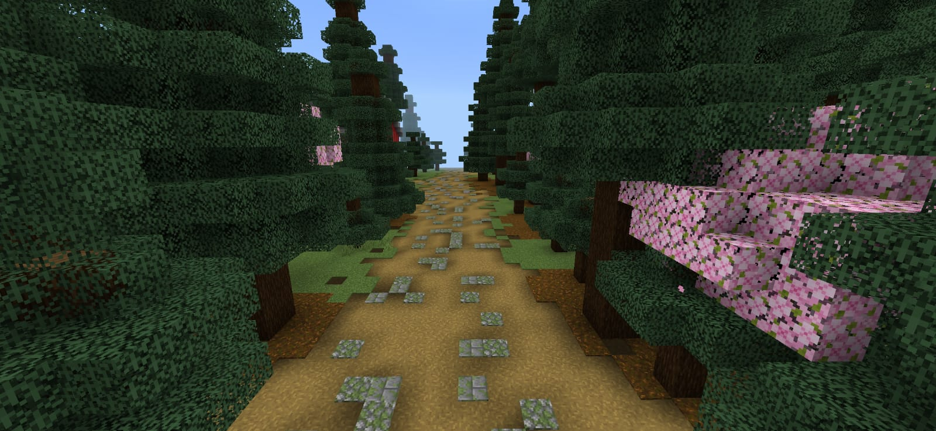
TRAIL
This trail is next to the country house. Trails are a great way to discover new places and be close to nature.

Slide 12
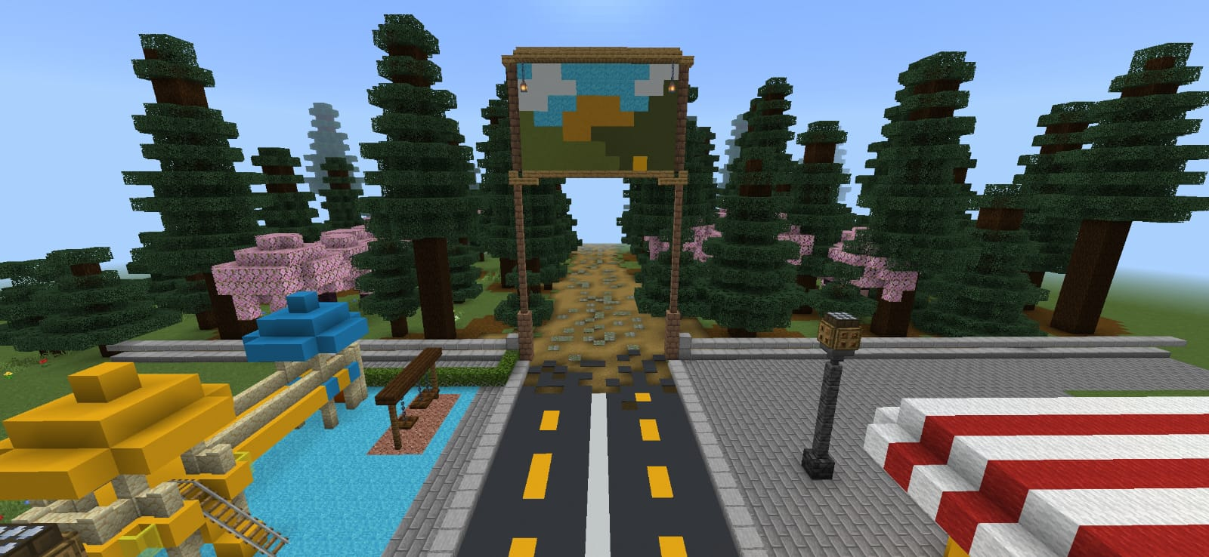
In front of this path, we have a playground, which is an advantageous structure, mainly for the child's mental, motor and social aspects. When playing on the playground, children experience countless stimuli while running, climbing stairs, climbing, jumping and interacting with other children.

Slide 13
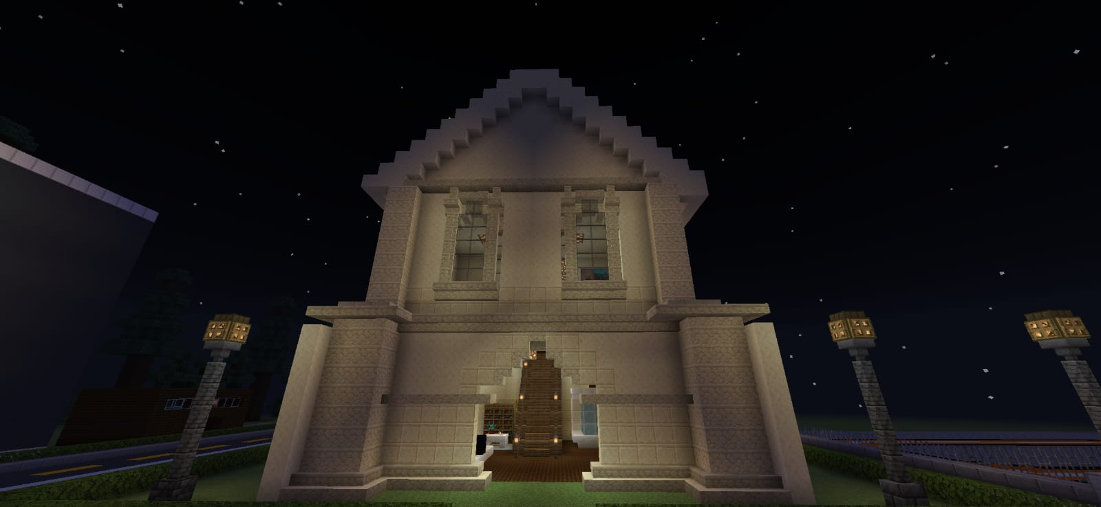
COLLEGE
At college you have the opportunity to learn about a career and everything that involves it. Therefore, being in an environment like this is seen as essential to achieving technical qualifications. There we have a computer laboratory.

Slide 14
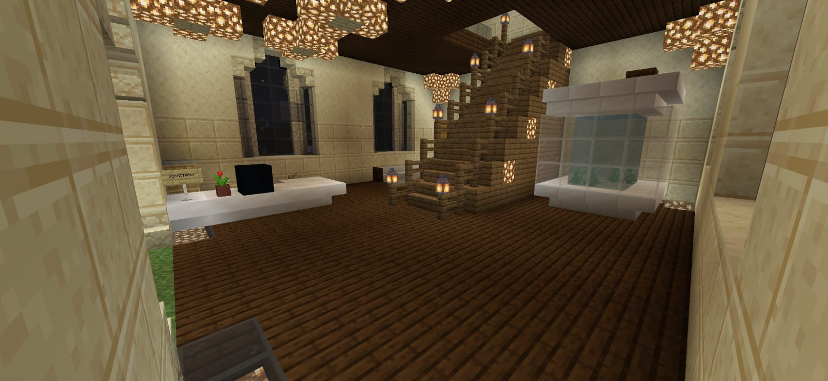
INSIDE THE COLLEGE

Slide 15
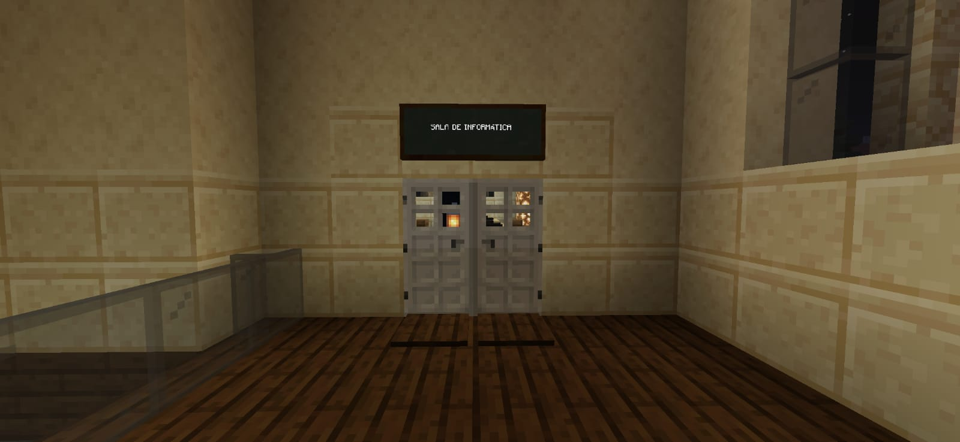
INSIDE THE COLLEGE

Slide 16
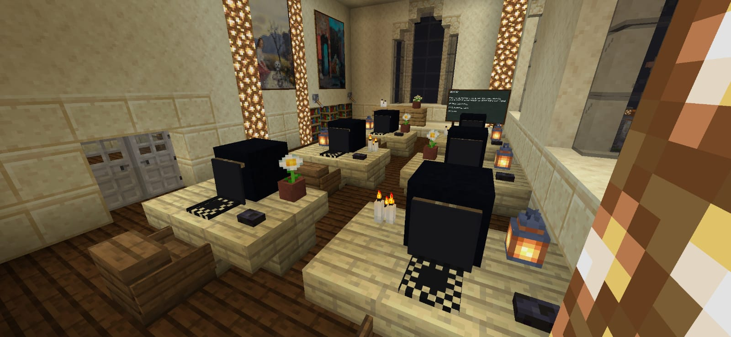
COMPUTER ROOM

Slide 17
WHAT DID WE LEARN FROM THIS ACTIVITY?
We try to make a sustainable city, we include renewable energy sources, we also include nature (lake, trees, plantations). And we learned that together we can try to build a more sustainable world.

Slide 18
THANK YOU FOR YOUR ATTENTION!

